Slide 1


Data Compression Algorithms
Literature Review on
Trần Tuấn Kiệt
Phạm Duy Tường Phước 2252662
Phan Hồng Quân 2252685

Slide 2

Table of contents
Overview on Compression Algorithms
Compression Algorithms
Results and Comparison

Slide 3
1. Overview on Compression Algorithms
Definition
Scope Hierarchy

Slide 4
Definition
“Compression algorithms are often categorized as either lossless or lossy techniques.” – Huan et al.
Lossless Technique: original data can be completely reconstructed
Lossy Technique: trade off some data errors to achieve better performance (execution time, compression ratio)

Slide 5
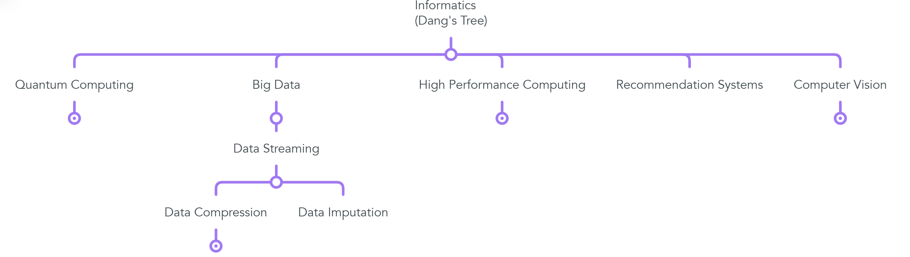
Scope Hierarchy

Slide 6
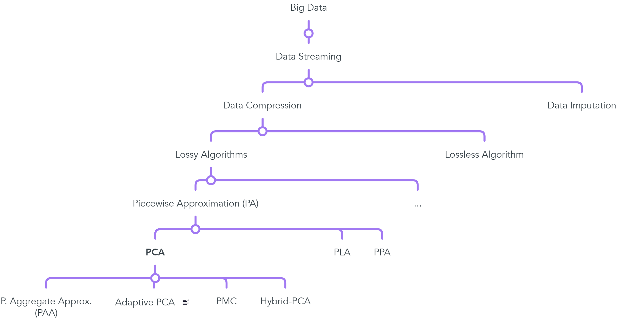
Scope Hierarchy

Slide 7

2. Compression Algorithms
Adaptive Piecewise Constant Approximation (APCA)
Poor Man Compression (PMC)
Hybrid - PCA

Slide 8
Adaptive Piecewise Constant Approximation (APCA)
Scans data in a selective order and inserts data into a window until the difference between maximum and minimum value is less than twice of maximum error rate threshold.
APCA | PCA
Varying window size | Fixed – size windows
Fewer data points | More data points
High delay time | Low delay time

Slide 9
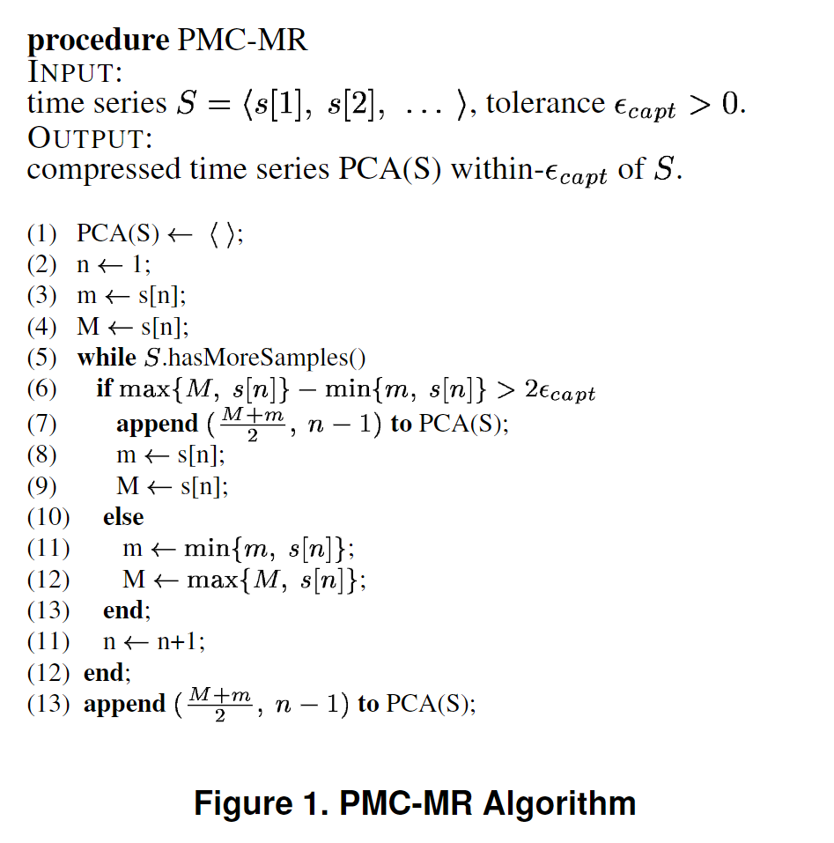
Poor Man Compression (PMC)

Slide 10
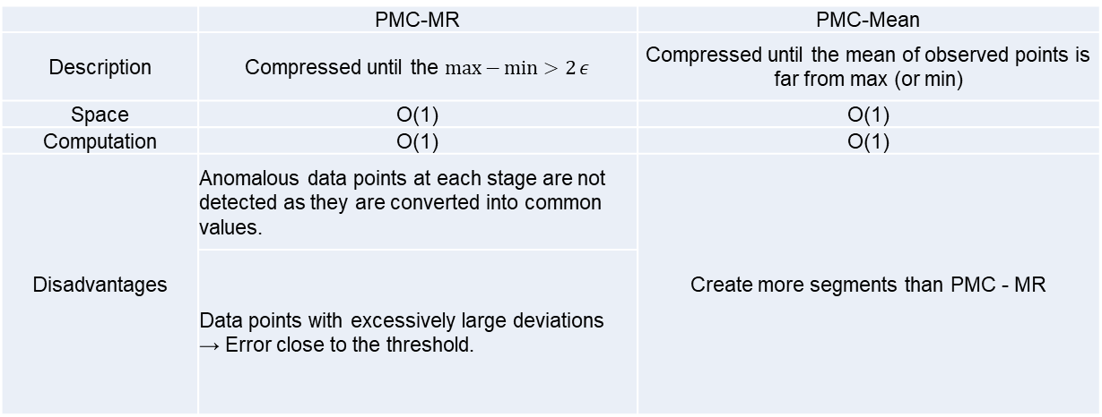
Poor Man Compression (PMC)
 | PMC-MR | PMC-Mean
Description | Compressed until the $\max{−\min{>2}}ε$ | Compressed until the mean of observed points is far from max (or min)
Space | O(1) | O(1)
Computation | O(1) | O(1)
Disadvantages | Anomalous data points at each stage are not detected as they are converted into common values. | Create more segments than PMC - MR
 | Data points with excessively large deviations → Error close to the threshold.

Slide 11
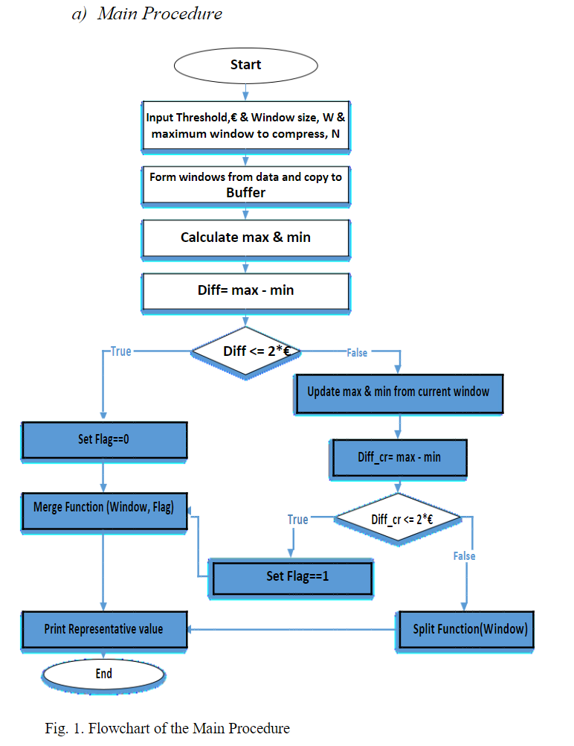
Hybrid – PCA
(Principle)

Slide 12
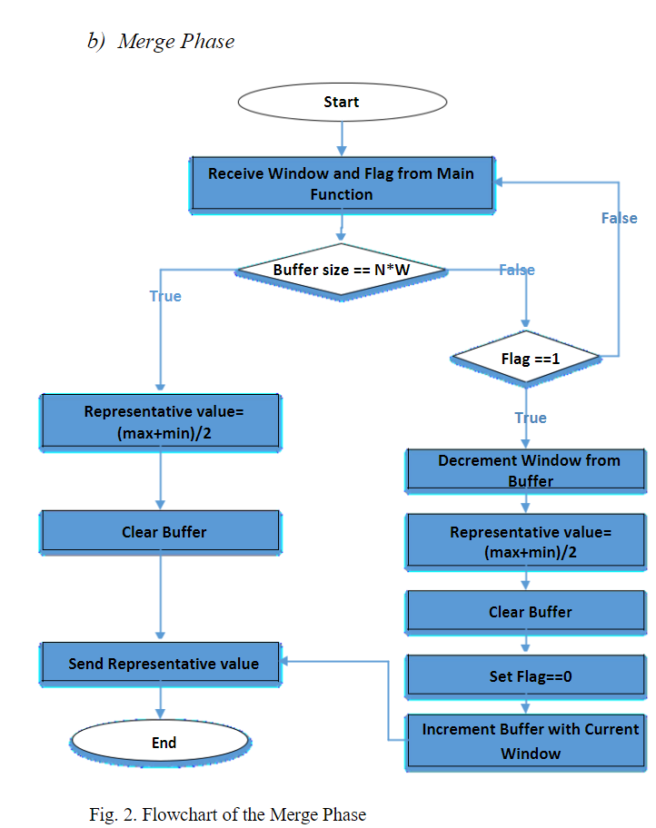
Hybrid – PCA
(Merge phase)

Slide 13
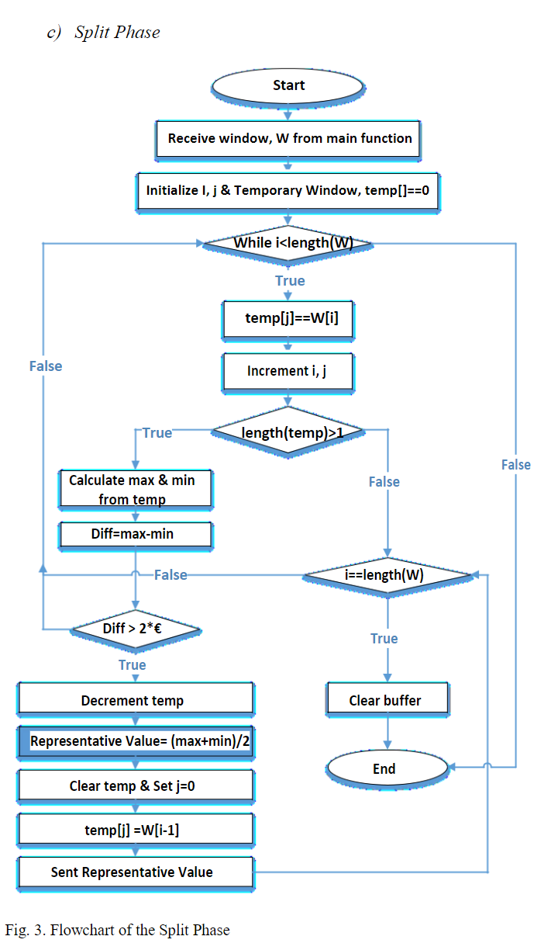
Hybrid – PCA
(Split phase)

Slide 14
3. Results and Comparison
Metrics
Results

Slide 15
Metrics
Compressed Data Points
Compression Ratio
RMSE of Compression
…

Slide 16
Results
 | PCA |  |  | APCA |  |  | Hybrid
 | Dataset 1 | Dataset 2 | Dataset 3 | Dataset 1 | Dataset 2 | Dataset 3 | Dataset 1 | Dataset 2 | Dataset 3
Compressed Data Points | 4765 | 4453 | 12519 | 1606 | 1387 | 4911 | 2332 | 2244 | 6712
Compression Ratio | 2,27 | 2,41 | 1,71 | 6,67 | 7,74 | 4,35 | 4,55 | 4,78 | 3,18
RMSE of compression | 0,21 | 0,2 | 0,3 | 0,28 | 0,31 | 0,46 | 0,21 | 0,29 | 0,41
Table 1: Statistics from reference [x]

Slide 17
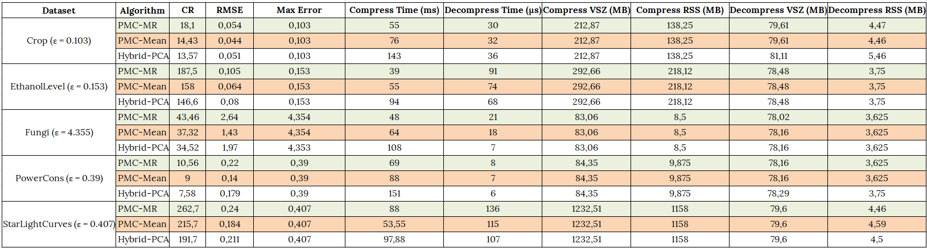
Results
Table 2: Statistics from reference [x]

Slide 18
References
[1] Huan, Thanh-Dang Diep, and Nam Thoai. A Performance Study of Piecewise Constant Approximation in Streaming Data Compression
[2] Iosif Lazaridis, Sharad Mehrotra. (2003). Capturing Sensor-Generated Time Series with Quality Guarantees.
[3] Arijit Ukil, Soma Bandyopadhyay, Aniruddha Sinha, Arpan Pal. (2015). Adaptive Sensor Data Compression In Iot Systems: Sensor Data Analytics Based Approach
[4] Atik Mahbub, Farhana Haque, Habibul Bashar, Mohammad Rezwanul Huq. (2019). Improved Piecewise Constant Approximation. Method for Compressing Data Streams

